Slide 1

Flexing Code Muscles with Azure Bicep
May 29th 2024

Slide 2


AJ Bajada
Managing Consultant @ Arinco
Azure, DevOps and automation enthusiast
And of course… Star Wars!
GitHub handle: tw3lveparsecs

Slide 3

Agenda
Bicep Parameter Files
Bicep Linter
User-defined Data Types
User-defined Functions
Deployment Scripts
Deployment Stacks
Microsoft Graph
Demo

Slide 4

Bicep Parameter Files
Supported in Bicep CLI version 0.18.4 or newer, Azure CLI version 2.47.0 or newer, and Azure PowerShell version 9.7.1 or newer.
You can use a Bicep parameters file with the .bicepparam file extension instead of JSON
A single Bicep file can have multiple Bicep parameters files associated with it. However, each Bicep parameters file is intended for one particular Bicep file.
You can compile Bicep parameters files into JSON parameters files using bicep build-params command and vice versa using bicep decompile-params command.
Bicep params support expressions where JSON do not.
Easily Generate param files via IDE.
Integration and IntelliSense from IDE.
Can use inline params and a local param file. Inline takes precedence if param value specified in both.
Reference: https://learn.microsoft.com/en-us/azure/azure-resource-manager/bicep/parameter-files?tabs=Bicep#parameters-file

Slide 5
Bicep Linter
The Bicep linter checks Bicep files for syntax errors and best practice violations.
Integrated into Bicep CLI and the Bicep extension for Visual Studio Code.
The default set of linter rules is minimal and taken from arm-ttk test cases. Set to warning by default.
You can overwrite the default settings, by using a bicepconfig.json file and applying your own custom settings.
Silence false positives in Bicep file using #disable-next-line <rule name>
Reference: https://learn.microsoft.com/en-us/azure/azure-resource-manager/bicep/linter

Slide 6
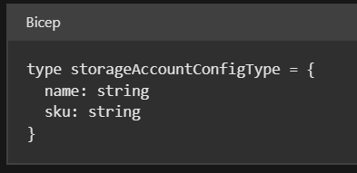
User-defined Data Types
You can now create your own data types in Bicep.
Bicep version 0.12.X or higher is required to use this feature.
You can use the type statement to define user-defined data types.
Export and import types into other Bicep files (available in 0.21.X or higher and currently in preview)
Reference: https://learn.microsoft.com/en-us/azure/azure-resource-manager/bicep/user-defined-data-types#import-types-between-bicep-files-preview

Slide 7

User-defined Functions
Within your Bicep file, you can create your own functions.
Bicep version 0.26.X or higher is required to use this feature.
Act as separate functions to standard Bicep functions.
Limitations
Can’t access variables
Can only use parameters defined within the function
Parameters can’t have default values
The function cant use the reference or list functions
Reference: https://learn.microsoft.com/en-us/azure/azure-resource-manager/bicep/user-defined-functions

Slide 8
Deployment Scripts
You can execute your own scripts to run in Bicep deployments.
Useful for when you need to do things like:
Create an object in Microsoft Entra ID.
Copy blobs
Create certificates
Lookup IP addresses
Supports Azure PowerShell and Azure CLI languages.
Utilises Azure Container Instances and storage account in the background to execute the deployment scripts. These resources can be set to be cleaned up after deployment.
Reference: https://learn.microsoft.com/en-us/azure/azure-resource-manager/bicep/deployment-script-bicep

Slide 9
Deployment Stacks
Enables the management of a group of Azure resources.
Great way to logically group resources together that have the same management lifecycle.
Update deployment stacks to add or remove resources.
Efficient way to run environment cleanup, like terraform destroy capability.
Can introduce Deny settings at the deployment stack level to prevent deletion and write operations.
Reference: https://learn.microsoft.com/en-us/azure/azure-resource-manager/bicep/deployment-stacks?tabs=azure-powershell

Slide 10
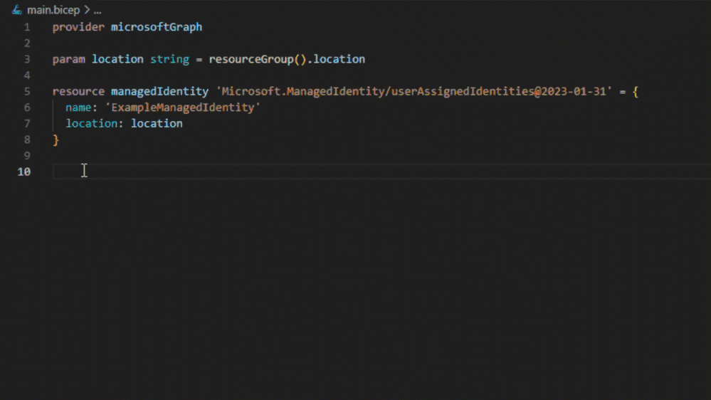
Microsoft Graph Extension
Currently in public preview. Available in Bicep version v0.27.1.
You can create, deploy, and manage supported Microsoft Graph resources in Bicep template files.
You can create Microsoft Entra ID resources, such as applications and groups.
Reference: https://learn.microsoft.com/en-us/graph/templates/overview-bicep-templates-for-graph

Slide 11

Demo
Reference: tw3lveparsecs/flexing-code-muscles-azure-bicep: This repository is a central hub for content and code for the Flexing Code Muscles with Azure Bicep presentation hosted on May 29th 2024. (github.com)

